Slide 1
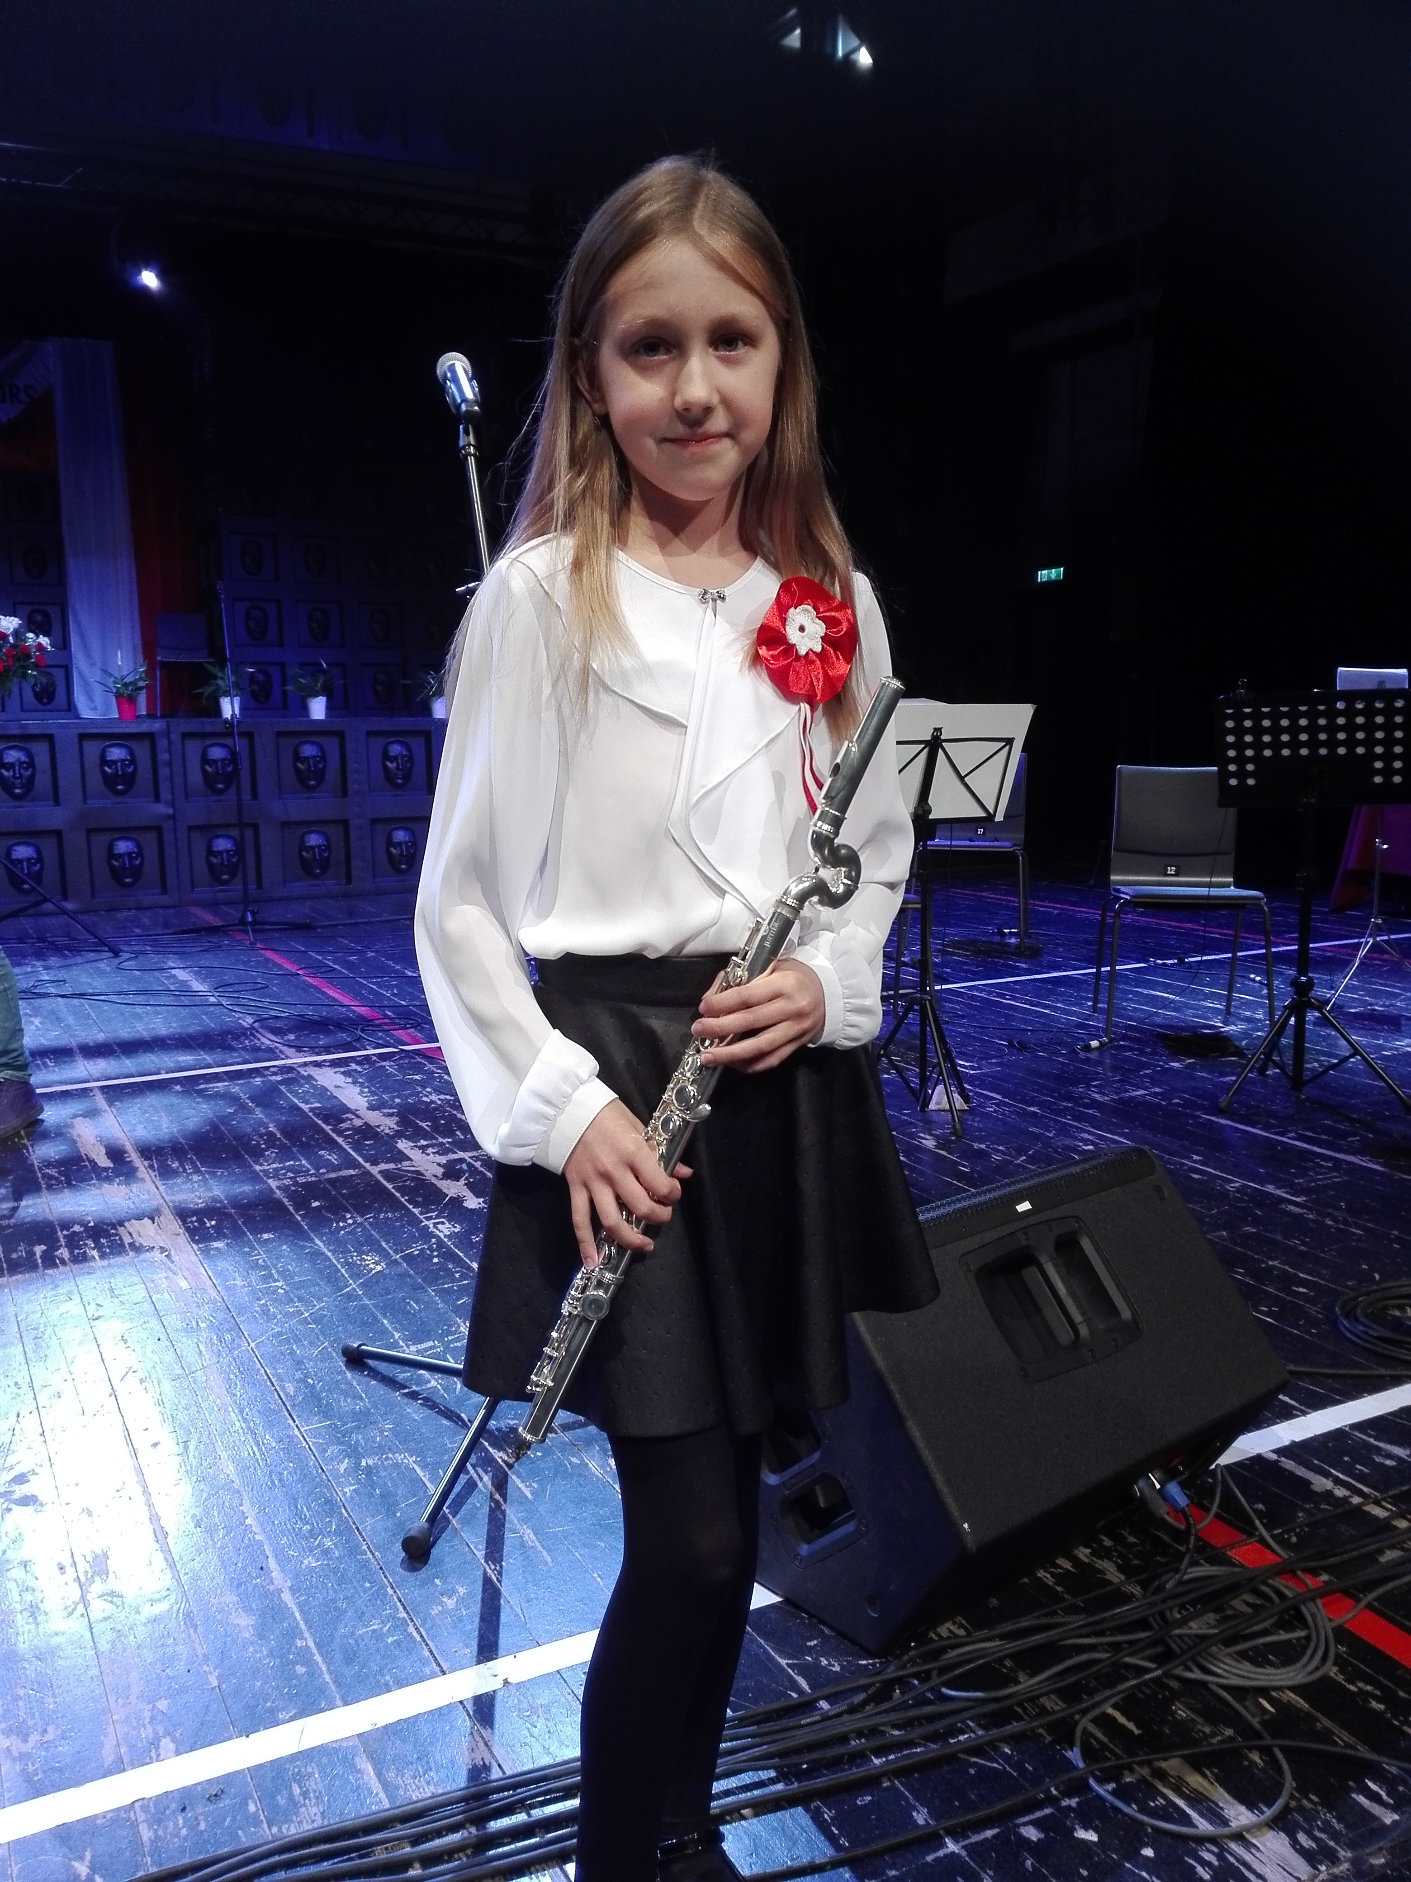
I play solo or with an orchestra

Slide 2
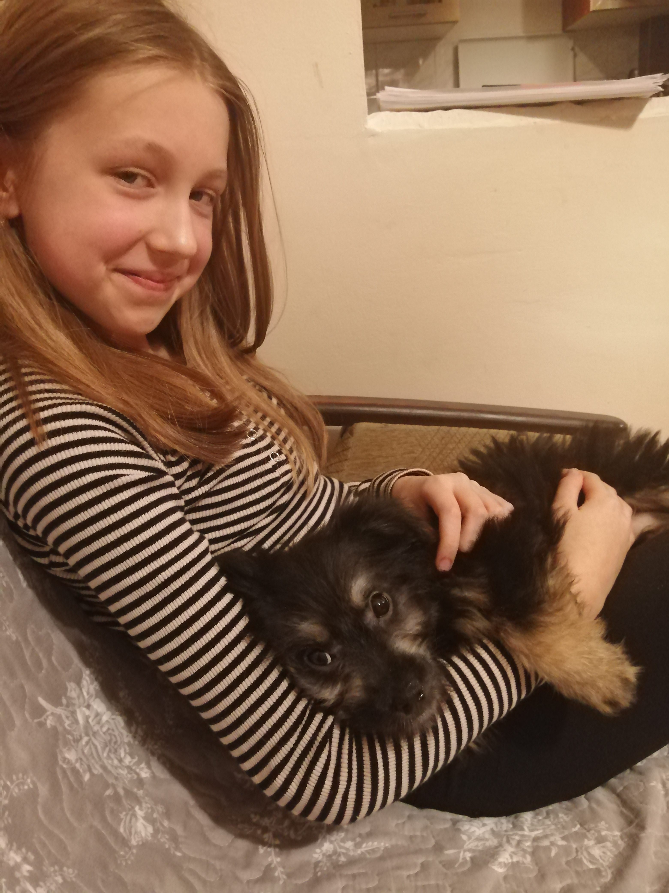
Everyday I go with my dog for a walk.

Slide 3
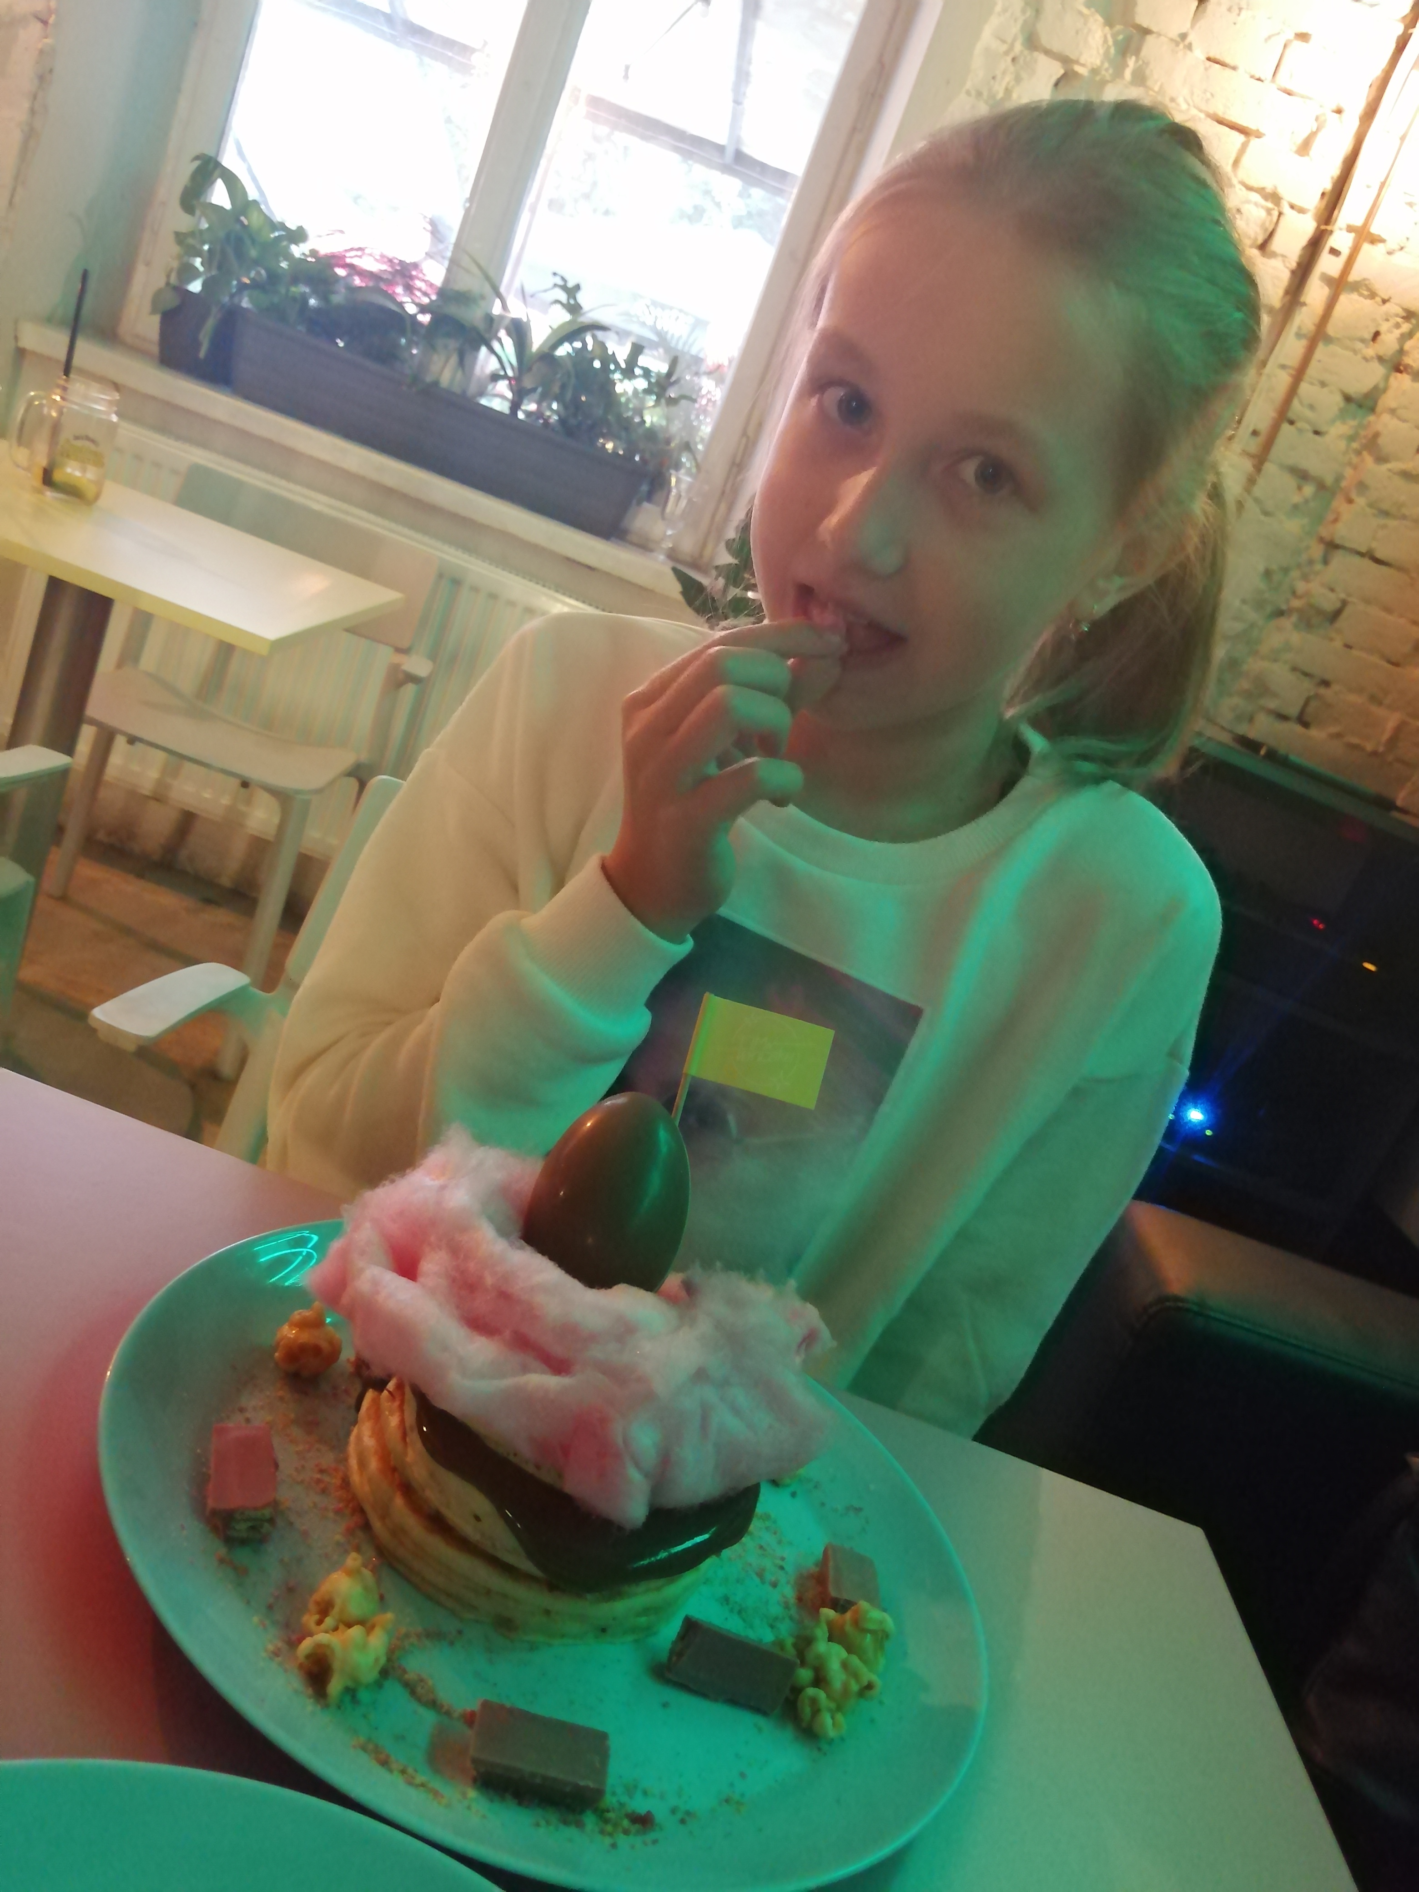
I like to eat
big
pancakes

